Slide 1



Maine Community Health Worker Initiative
October 21, 2014

Slide 2
Maine CHW Initiative
Project Director for SIM CHW Initiative
  Barbara Ginley, Maine Migrant Health Program
Maine CDC Leadership for CHW Initiative
  Jim Braddick, Program Manager, Maine CDC Asthma Program
  Debra Wigand, Director, Maine CDC Division of Population Health
Notes:
Collaboration between Maine CDC, Medical Care Development, Maine Migrant Health

Slide 3
Evidence Base to support use of chws

Slide 4
Evidence base For use of CHWs
Contributions of CHWS:
  Improving health outcomes
  Supporting appropriate utilization of health care services
  Increased cost savings
    Chronic disease support
    Cancer screening
    High risk or high consumers of health care services

Slide 5
improved quality
Utilization: Post-Hospitalization Outcomes
  2 urban university based hospitals targeting low-income patients
  Patients working w/CHW during 2 weeks post-discharge: more likely to obtain timely post-discharge PC, ↑ improvement in MH status, higher quality discharge communications and less likely to have multiple readmissions
Cancer Screening
  6 studies (urban and rural) focused on Pap Smears
  Greater proportion of patients screened & larger change in #s ever screened
Chronic Care: Hispanic patients newly diagnosed type 2 DM
  CHW vs. CM vs. usual care
  Reduced ER visits
  Improved diet, medication adherence and physical activity
Notes:
. This prospective randomized design evaluated the relative effectiveness of a CHW intervention among Hispanic persons with newly diagnosed type 2 diabetes, as compared with usual clinic practice in three inner-city health centers. In sum, 189 Hispanic patients newly diagnosed with type 2 diabetes were randomly assigned to one of three 6-month diabetes management approaches--CHW, case management, and standard provider care--and assessed for diabetes-related health measures and clinical indicators at baseline and postintervention. Participants in the CHW group achieved greater improvements than did the controls in program measures: health status, emergency department utilization, dietary habits, physical activity, and medication adherence. They also had 2.9 times greater odds of decreasing body mass index

Slide 6


Cost savings: ICER Review
14 studies
Contexts:
  Chronic disease support: asthma, diabetes, and HIV
  Cancer screening
  Interventions for high consumers of healthcare resources or other high-risk individuals
Majority of studies showed net cost savings over 6 months to 2 years relative to control groups
Notes:
Improvement in Health and Utilization
Components of CHW programs likely or highly likely to contribute to effectiveness- training 40+ hours, shared trait, home visits/connections interactions of 69+ minutes with patient,
Study designs varied, including randomized controlled trials, comparative cohort studies, assessment of the change in costs in a single cohort prior to and following CHW interventions, and simulation models.

Slide 7
CHWs as part of SIM

Slide 8
Maine State Innovation Model (SIM) Initiative
Primary Innovations
Strengthen Primary Care
Integrate Physical & Behavioral Health Care
Develop New Workforce Models
Support development & use of common
Support development & use of common quality & cost measures
Develop standard cost & quality reporting
Develop New Payment Models
Centralize Data & Analysis
Engage People & Communities
Expand access to Patient Centered Medical Home (PCMH) / Health Home (HH) models
Provide quality improvement support, recognition & rewards to PCMH/HH practices
Provide leadership development for physicians and practice leaders
Provide learning collaborative & technical assistance to help BH organizations move to Health Homes model, and to improve integration of physical and BH
Provide incentives & assistance to BH providers to participate in HealthInfoNet
Develop BH quality measures
Develop Community Health Worker pilot in 5 communities
Develop Diabetes transitions
Develop Diabetes Prevention Program
Provide training for PCMH/HH practices to improve care for developmental disabilities
Align Long Term Care with PCMH/HH models
Improve care transitions
Support development of Accountable Community Organizations (ACOs) t
Offer ACOs peer-to-peer learning
Develop common quality measures
Engage employers, payers, and consumers
Develop value-based insurance & benefit design
Engage patients and families as active participants in their care
Conduct consumer engagement campaign, with special focus on MaineCare members
Promote Shared Decision Making, tools including Choosing Wisely
Measure & publicly report patient experience
Maine’s SIM initiative is a state-led, federally-funded public-private partnership that seeks to develop, accelerate and test a set of innovations to transform health care delivery and payment.
Notes:
-As we move thru Yr1 it is an important reminder that the CHW Initiative is certainly intended to move towards the Triple AIM goals but was conceived as a workforce development effort to develop and support an emerging workforce in Maine that allows team members to practice at the height of their license, to address unmet needs in communities with a workforce model that addresses social determinants and community engagement.

Slide 9
MAINE CHW INITIATIVE- TIMELINE FOR YR 1
Background/Enviro Scan Literature Review, Inventory of ME CHWs, Other States, Best Practices, compiled to inform development of stakeholder group and pilots
Recommendations for CHW Pilots
Rationale, selection criteria, performance metrics to develop CHW programs
Mentoring/Supporting Pilot Sites
Provide ongoing technical assistance and support to pilots in their initial year of implementation.
Summer ‘13
Fall ‘13
Winter ‘14
Spring ‘14
Summer ‘14
YR 2
Stakeholder Convening
Engage CHW allies and interested parties to support long-term goal of sustainability*
Selection and Start-up of Pilots
Focus will be on initial stage of implmentation, training, recruitment, supervision & support
Reflection and Fine-tuning of YR 1

Slide 10
Chws and national experience

Slide 11
Defining Characteristics of CHWs
Knowledge/Understanding of their communities that cannot be replaced with formal education;
Have experience providing services IN the community relating as peers not clients/patients, work informed by understanding of home environments, community experience;
Focus on social determinants of health;
Serve as advocate and intermediary
Notes:
Experience- based expertise is what sets CHWs apart.
Is not a clinician
Works from a place of trust and relationship
Improve care experience for both patient and provider

Slide 12
National: CHWs across the US
More than 120,000 CHWs on the job across our country
Scope of work:
  Health coaching, peer support, referrals, liaison/advocate, interpreter, care management, chronic disease mgmt., educator, transportation, navigator, etc.
Growing support/recognition of CHWs (ACA/IOM/CDC)
Research/evidence supporting the comparative and cost effectiveness of CHWs
Notes:
-2 of the 6 states part of the SIM testing cohort explicitly state that CHWs will play a role in their efforts to transform the hc system.
- BOLS is actively updating its definition of CHWs in an effort to better document the reach and evolution of the workforce

Slide 13
Maine experience

Slide 14
Maine: Status of CHWs
13 entities/50+ CHWs, (community health) outreach workers, promotoras, patient navigators, resource counselors, life-skills trainer, etc.
3 respondents use common curriculum (UNE/PPH/AHEC Channels)
3/4 of respondents identified the shared trait/identity as being a key component of who their CHWs were
Variability in- names/roles, formal education requirements, training, background, organizational experience, pay
Notes:
1. Convenience Sample- good geographic representation- diversity in terms of target population/focus;
2. All training is currently done through organizations offering programming, employment or stipends;
3. No common definition or nomenclature- MACHWA, I HS, MHP, USRRS, MA-PNP, US Office of Elder Affairs,

Slide 15
CHWs in Maine
BLS/Occupational Employment and Wage Estimates, 2013
Estimated Number Employed CHWs in Maine | 240
Mean Hourly Wage of CHWs in ME | $16.20
Mean Annual Wage of CHWs in ME | $33,700
Median wage, all occupations in Maine (2012) | $32,590

Slide 16
Maine CHW Stakeholder Group convened under sim
Meets monthly beginning in October 2013
Informs CHW Initiative infrastructure and systems development
30 active participants; 100 individuals receiving information
Core activities to date:
  Definition of community health worker (CHW)
  Core roles and responsibilities of a CHW
  Cross walk of roles and responsibilities to skills and attributes of CHWs
  Recommendations for recruitment of CHWs

Slide 17
Maine CHW pilots
Four pilots have been identified to:
  Demonstrate the value of integrating CHWs into the health care team;
  Provide models that can be replicated and emulated across the state;
  Build a core group of experienced CHWs who can provide leadership and community engagement to drive the ongoing development of the system.
Notes:
CHW RFP can be found at above website
I will not be entertaining questions in regards to the RFP
Goals for our time together
As an introduction to the CHW Project under SIM
Participants will be able to discuss recent policy updates, payment reform efforts and best practices specific to Community Health Workers and their potential impact on Maine's healthcare system.
Participants will be able to identify and describe 3 practices to support successful integration of CHWs into multidisciplinary teams.

Slide 18
Key future milestones for
Maine CHW initiative
Provide technical assistance and support to the 4 CHW pilots
Educate and inform on professional identity and opportunities under the CHW model to support healthcare transformation and health equity
Develop sustainability recommendation; including rationale and mechanism for payment/reimbursement for CHW services
Recommend and adopt a CHW Core Curriculum to serve as the basis of CHW training
Develop recommendations related to the process for certifying or registering CHWs, including identification of entities to do so
  Identification and naming of requisite experience, formal education of CHWs
  Identification of process for grandfathering CHWs already working in Maine
  Adoption of language to distinguish between “certified” CHWs and those who choose not to be certified (or eligible for reimbursement)

Slide 19
National context

Slide 20
CHWs under the Affordable Care Act
….. cites the use of CHWs as an effective way to improve health outcomes as part of a health care team while containing costs.
Operationalized by:
Preventive Services
Health Homes
State Innovation Models
Affordable Care Act Opportunities for Community Health Workers, Katzen and Morgan, 2014

Slide 21
Medicaid Rule Change- Prevention Services
CMS Ruling - July 2013:
  Allows preventive services recommended by physicians or other licensed providers to be provided, at state option, by practitioners other than physicians or other licensed practitioners.
  States may reimburse for preventive services “recommended by a physician or other licensed practitioner…within the scope of their practice under State law”.
Notes:
- A few states have operationalized this in a way that the services are ordered by a clinician and the CHW is supervised by that clinician
Care coordination and educational counseling6
• Home visiting
• Group health education (potentially reimbursable as long as Medicaid enrollees have some one-on-one interaction with the counselor)
• Community health worker services7, such as asthma education to Medicaid enrollees
• Lactation consultation

Slide 22
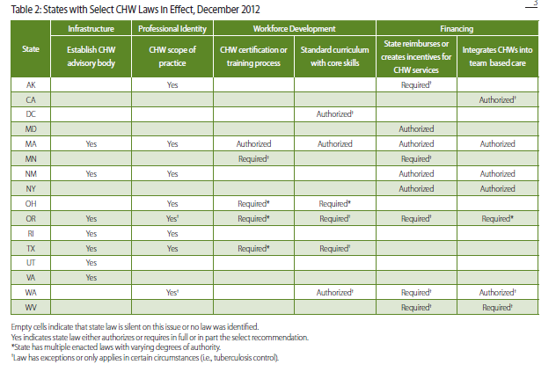
CHW Laws by State- Dec. 2012
Laws
Notes:
-Intermediate steps to get to reimbursement- fee for service and/or bundled payments
- Payers expect rightly so uniformity around what a unit of service is, preventative services by CHW needs to be broken down into common training, common competencies, common scope

Slide 23
Discussion with
Payment reform subcommittee
What is needed in order to support adding the services of community health workers?
  By payers – as part of benefits covered
  By health care provider systems – as part of a health care team covered by bundled payment
  As part of new reimbursement models
What recommendations do you have as we move forward
What other information can we provide; how would you like to be kept informed of our work

Slide 24
Web Resources
Maine Community Health Worker Initiative: www.mechw.org
Institute for Clinical Effectiveness and Review: http://cepac.icer-review.org/?page_id=1066
Migrant Health Promotion: www.migranthealth.org
Centers for Disease Control and Prevention: http://www.cdc.gov/dhdsp/pubs/chw_elearning.htm
Community Health Worker National Education Collaborative http://www.chw-nec.org/index.cfm
American Public Health Association: http://www.apha.org
Association of State and Territorial Health Officials: http://www.astho.org/community-Health-Workers/
Addressing Chronic Disease Through CHWs: http://www.cdc.gov/dhdsp/docs/chw_brief.pdf

Slide 25
References
K. Volkermann, T. Castenaras, Community Health Workers and the Primary Care Home, National Farmworker Health Conference, May, 2008 (power-point presentation).
A. Lee ( Migrant Health Promotion) and the Virginia Garcia Memorial Health Center, Promotoras and the PCMH, Western Migrant Stream Forum, 2011 (power-point presentation)
1. E. Lee Rosenthal, J. Nell Brownstein, Carl H. Rush, Gail R. Hirsch, Anne M. Willaert, Jacqueline R. Scott, Lisa R. Holderby and Durrell J. Fox; Community Health Workers: Part Of The Solution. Health Affairs, 29, no.7 (2010):1338-1342

Slide 26
References
Babamoto K, Sey KA, Camilleri AJ, Karlan VJ, Catalasan J, Morisky DE. Improving diabetes care and health measures among Hispanics using community health workers: results from a randomized, controlled trial. Health Educ Behav. 2009;36:113–126
Brownstein JN, Hirsch G, Rosenthal L, Rush C. Community health workers
“101” for primary care providers and other stakeholders in health care systems. J Ambulatory Care Management. 2011; 34, No. 3, 210–220
Kangovi S, Mitra N, Grande D, White ML, McCollum S, Sellman J, Shannon RP, Long JA, Patient-centered community health worker intervention to improve post hospital outcomes: A randomized clinical trial. JAMA Internal Medicine. 2014; DOI: 10.1001/jamainternmed.2013.14327,
Proceedings/Report from the, New England Comparative Effectiveness Public Advocacy Council, June 28,3013 on Community Health Workers: A Review of Program Evolution, Evidence on Effectiveness and Value, and Status of Workforce Development in New England.
US CDC, National Center for Chronic Disease Prevention and Health Promotion. A Summary of State Laws for Community Health Workers. July, 2013.
.

Slide 27
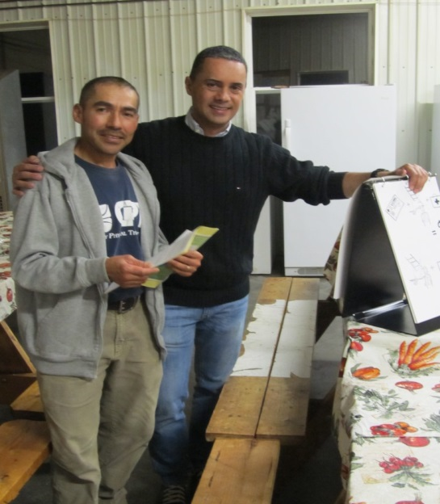
Maine CHW Initiative
For more information, please contact:
Barbara Ginley
9 Green Street P.O. Box 405
Augusta, ME 04332-0405
(207) 441-3364
bginley@mainemigrant.org

